Slide 1
Building Office 365 SPAs with Angular & CORS

Slide 2






Andrew Connell
www.AndrewConnell.com
me@AndrewConnell.com
@andrewconnell
Full stack web developer & instructor
Co-host, Microsoft Cloud Show – www.MicrosoftCloudShow.com
Hands-On SharePoint Training Critical Path Training - www.CriticalPathTraining.com
On-Demand SharePoint Training Pluralsight – www.Pluralsight.com

Slide 3
Topics
Office 365 Overview
Azure Active Directory
Office 365 APIs
Azure AD ADAL

Slide 4
Office 365 Overview

Slide 5
What is Office 365?
SharePoint Online
Exchange Online
Skype for Business
Yammer
OneDrive for Business

Slide 6
Office 365 Pitch
Fastest growing Microsoft product
80% of Enterprises using Office 365
4 trillion emails
830 million monthly meetings
470PB storage
Contains collaborative data in SharePoint
Contains Exchange data (contacts, calendar & email)
File storage

Slide 7
But why should you care as a developer?

Slide 8
PaaS Platform As A Service

Slide 9
ePaaS Enterprise Platform As A Service

Slide 10
Office 365 for Developers
All data exposed via APIs
Native SDKs (.NET, iOS, Android, Cordova & Xamarin)
REST APIs (based on OData v4.0)
All APIs secured using Azure AD

Slide 11
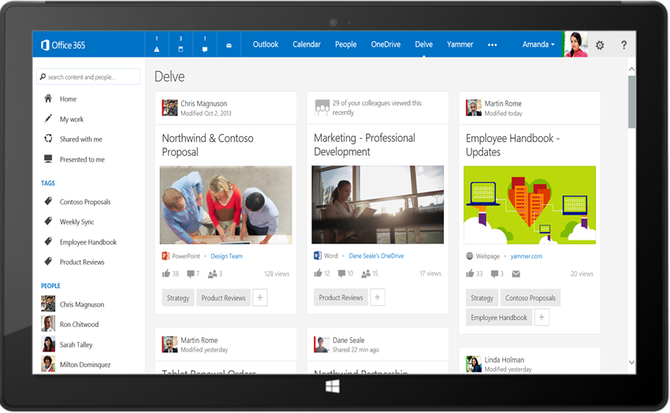
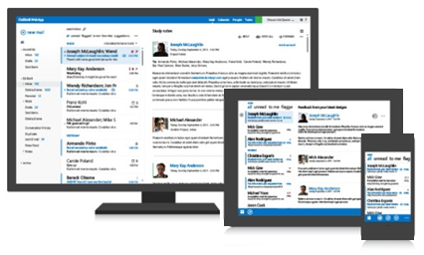




Office 365 APIs
Your App
https://graph.microsoft.com/
USERS
GROUPS
FILES
MAIL
CALENDAR
TASKS
Insights and relationships from Office Graph

Slide 12
Azure AD & Office 365

Slide 13
Many Organizations Have Azure AD
Azure AD manages identity data for
>5 M organizations
86%
of Fortune 500 companies on Microsoft Cloud (Azure, O365, CRM Online and PowerBI)
More than
500 M objects hosted on Azure Active Directory
50 M Office 365 users active every month
1 Trillion
Azure AD authentications since the release of the service
>1 Billion authentications every day on Azure AD
Every Office 365 and Microsoft Azure customer uses Azure Active Directory

Slide 14
Single Auth Flow for Office 365
OpenID Connect & OAuth 2.0
No capturing user credentials
Fine-grained access scopes
Supports MFA & federated user sign-in
Long-term access through refresh tokens

Slide 15
Secure Protocol
OpenID Connect & OAuth 2.0
No capturing user credentials
Fine-grained access scopes
Supports MFA & federated user sign-in
Long-term access through refresh tokens

Slide 16
ADAL JS

Slide 17
Secure Client-Side Apps with ADAL JS
Azure AD now supports the OAuth implicit flow
Enables 100% client-side authentication
Apps must explicitly opt-in to this flow option
ADAL JS
Comprised in two components:
adal.js – core… not designed for direct use
adal.angular.js – Angular service

Slide 18
ADAL JS – Two Primary Uses / Roles
Watches all HTTP requests to specific endpoint
If request matches specific endpoint
Authenticates the user via Azure AD
Obtains OAuth 2.0 access token for user & requested endpoint
Includes access token in HTTP request header
“Secures” specified Angular routes
Adds a property to routes

Slide 19
DEMO – Secure Angular Apps with Azure AD & Office 365
Notes:
Show the site in SharePoint
Show the receipts in OneDrive for Business
Show Azure AD
Show the application

Slide 20

Thanks! Questions?
github.com/andrewconnell/pres-o365-ngapps

